Slide 1
CROWDFUNDING PLATFORM PERFORMANCE ANALYSIS
MGMT 586 Final Project
Session 1 Group 8:
Anil Cavale
Angelina Joseph
Eshan Sharma
Mansha Kalra
Sriya Musunuru

Slide 2
01
Company Brief
05
Feature Engineering
02
Data Summary
06
Analysis & Insights
03
Business Questions
07
Predictive Analysis
Agenda
04
Data Cleaning
08
Recommendation And Next Steps

Slide 3

Company Introduction
Kickstarter is a crowd funding platform where creators share their project ideas based on a wide range of categories and a large number of people pool in their money to help creators realize their set goal amount.
As a result, Kickstarter helps creators get their new projects get off the ground.
Since their inception in 2009, 20 million people have backed a project, $6.1 billion has been pledged and roughly 209,220 projects have been successfully funded.¹
Kickstarter makes commission of up to 3-5% via projects which achieve their goal amount.
¹Source: About — Kickstarter

Slide 4
Data Dictionary
ID | Project ID
Name | Name of the Project
Category | The core category of a project
Main_category | Film & Video, Music, Publishing, Games, Technology, Art, Design, Food, Fashion, Theater, Comics, Photography, Crafts, Journalism, Dance
Currency | GBP, USD, CAD, AUD, NOK, EUR, MXN, SEK, NZD, CHF, DKK, HKD, SGD, JPY
Goal | Total goal amount decided by the host
Pledged | Total pledged amount contributed by the supporters
Deadline | Tentative end date of the project campaign
Launched | The day the project campaign became live
State | What is the current state of the project? Successful, Failed etc.
Backers | The number of supporters of the project
Country | Location from where the project is hosted
Usd_pledged_real | USD converted amount contributed by supporters
Usd_goal_real | USD converted amount decided by the project host

Slide 5
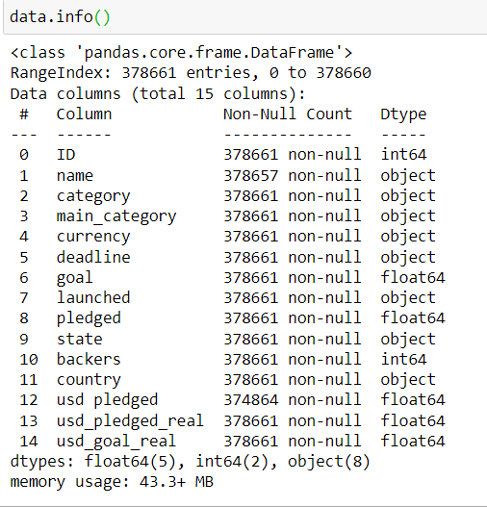
Data Summary
`
38.5M+ Backers
15 Main categories
Level of Data
22 Countries
378k + Projects
159 Sub categories
2009 - 2018
40% Success
60% Fail
Extracted from Kickstarter.com and Sourced openly on Kaggle
Includes attributes including country where the project is hosted from, goal amount to be raised, pledged amount contributed, number of backers for a project, launch and deadline of projects, categories etc.
Total of 378661 records with 15 columns.

Slide 6
Internal Stakeholder
Business Questions
How has the platform gained popularity over the years?
What are the most and least popular countries for Kickstarter Campaigns?
Which category of projects is doing well on the platform?
How does Success Rate vary across factors of Category?
Two sets of target audience have been identified who can benefit from the given analysis –
Kickstarter (Internal stakeholder): The company can utilize insights from historical performance of the platform to optimize their services
End User (External stakeholder): Project creators can benefit from understanding whether Kickstarter would be the right choice of platform for raising funds for their projects
External Stakeholder
About Kickstarter
What drives the success and failure of campaigns?
How does the number of backers change over duration of campaign?
Given basic project attributes like Category, Intended duration and Target Goal amount, what is the probability that a given campaign will succeed?

Slide 7
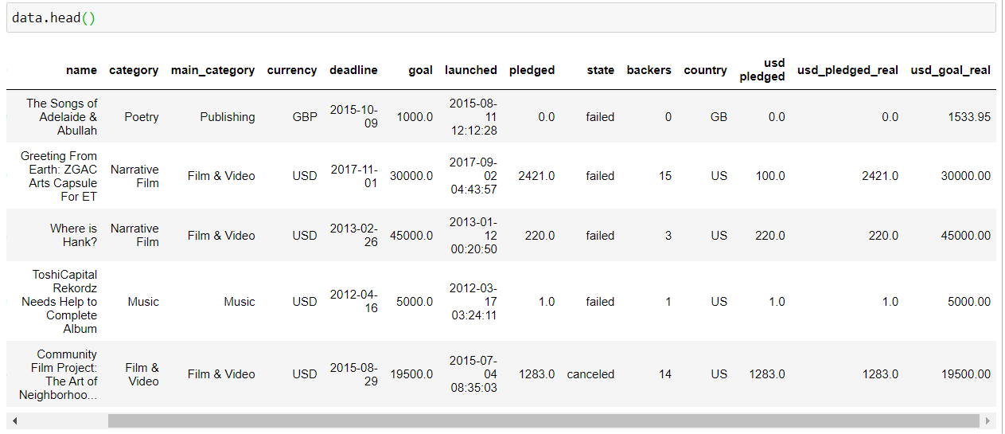
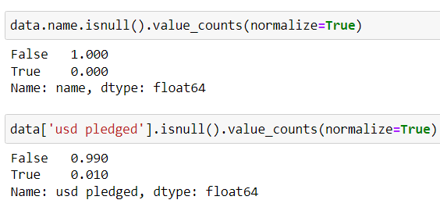
Data Investigation
1
2
1
3
4
The currency is not uniform holding no business impact to gather insights.
Timestamp is not required to calculate duration projects.
The different states like suspended and cancelled have not been used since they are scraped campaigns.
Unnecessary column with erroneous values
Null values exist in the name and usd_pledged_real attributes
5
5
5

Slide 8




Data Cleaning and Pre-processing
Dropped columns – usd pledged, goal, pledged
Reasoning – No uniformity in currency, many null values. More informational and uniform amount data is available(usd_goal_real, usd_pledged_real)
1
2
Dropped rows – 4 rows of the project name attribute
Reasoning – Values were NaN
3
Dropped rows – Rows of Country with value “N,0”
Reasoning – Countries with N,0 values have many null values and no business relevance
4
Dropped rows – Removing rows with state values (neither Successful nor Failed)
Reasoning – Live, Suspended, Cancelled project states have no significant impact on our business problem.

Slide 9
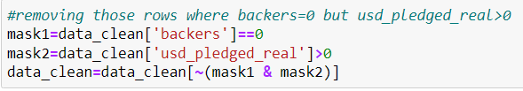
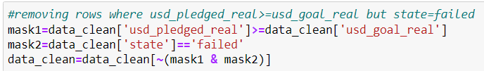
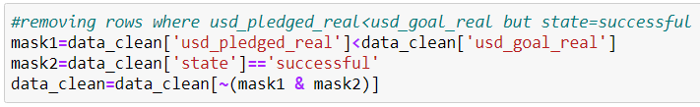


5
Dropped rows – Where Backers = 0 but Pledged Amount > 0
Reasoning – Business Anomaly, heavily impacts analysis
6
Dropped rows – where Pledged Amount >= Goal Amount but State = failed
Reasoning – Business Anomaly, heavily impacts analysis
7
Dropped rows – where Pledged Amount < Goal Amount but State = successful
Reasoning – Business Anomaly, heavily impacts analysis
8
New Columns – Extracted new attributes “Year”, “Month” from the launch date
Reasoning – To conduct a year-wise and month-wise analysis.
9
Dropped row – Entries with dates of the year 1970
Reasoning – This is a default value assigned to projects which have no defined launch date, dropped from analysis

Slide 10
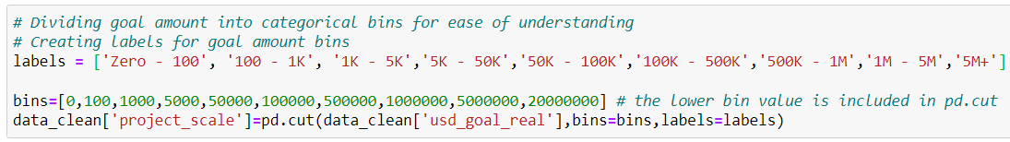
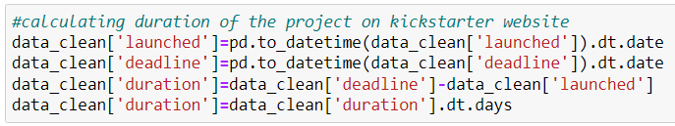
Feature Engineering
1
2
Status Flag
Defined a new variable called Success, Projects having status as successful is 1 and failure is 0
Difference
Calculated the Amount difference between the Goal Amount and the Pledged Amount
1
3
4
2
Goal Amount Bins
Divided the Goal Amount into categorical bins for ease of visualization
Labels assigned: 'Zero - 100', '100 - 1K', '1K - 5K’ and so on
Duration
Conversion of launched, deadline (type=object) to (type=datetime)
Calculated duration by subtracting the launched date from the deadline
Extracted the days from the new datetime variable for further analysis
3
4

Slide 11
Business Impact On Internal Stakeholders
Customer Engagement
Revenue Generation
Kickstarter – Crowdfunding Platform
Despite being red, Mars is a cold place, not hot. It’s full of iron oxide dust
Venus has a beautiful name and is the second planet from the Sun
How has the platform gained popularity over the years?
What are the most and least popular countries for Kickstarter Campaigns?
Which category of projects is doing well on the platform?
How does Success Rate vary across factors of Category?

Slide 12
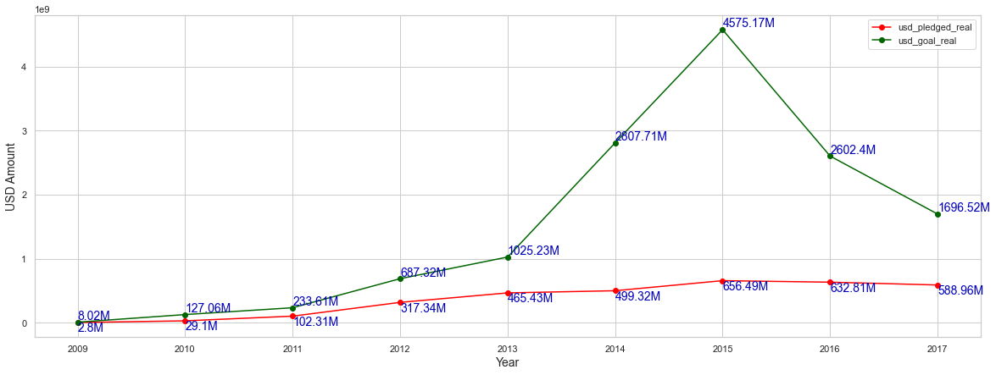
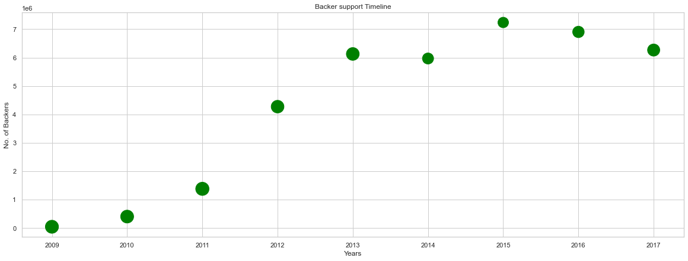
How has Kickstarter gained Popularity over the years?
Till the year 2015, Kickstarter had a steady growth in terms of the business happening over the platform and growth of backers.
After 2015, we observe a downfall in the goal amounts while the pledged amount stand steady.
After 2015, we observe a fall in the number of backer support as well.

Slide 13
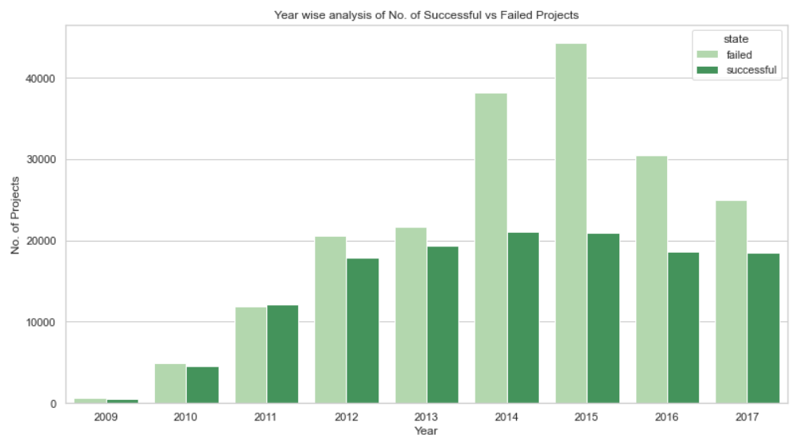
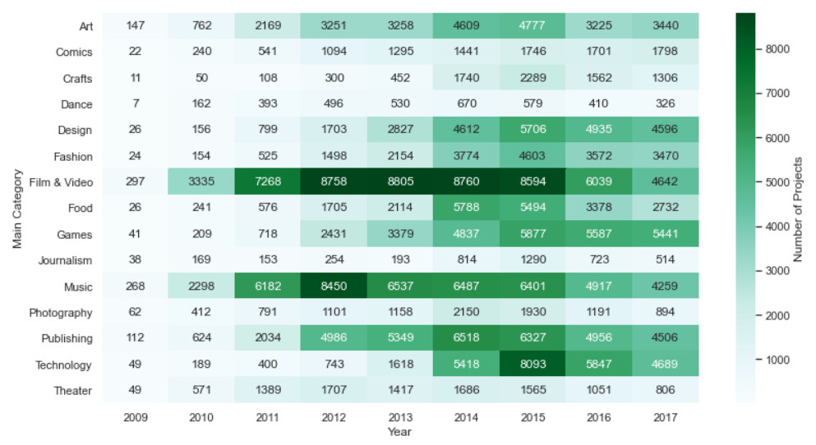
How has Kickstarter gained Popularity over the years?
YOY growth of projects on Kickstarter
Year and category wise Heat Map based on the number of campaigns
On a YOY comparison, the number of projects on Kickstarter drastically increased during the years 2014 & 2015 and post 2015 there has been a significant drop in the number of projects on Kickstarter.
We can also conclude the number of failed projects is consistently higher than the successful projects with an exception in the year 2011 where the number of successful projects were slightly higher than the failed projects.
The Heat Map helps us find the categorical distribution of projects across the years.
Music and Film & Video have the highest successful projects on Kickstarter.
The Heat Map further helps us verify this point that since the proportion of Film & Video and Music projects are relatively higher than the other categories in 2011, the year 2011 has slightly more successful projects than failed projects.

Slide 14
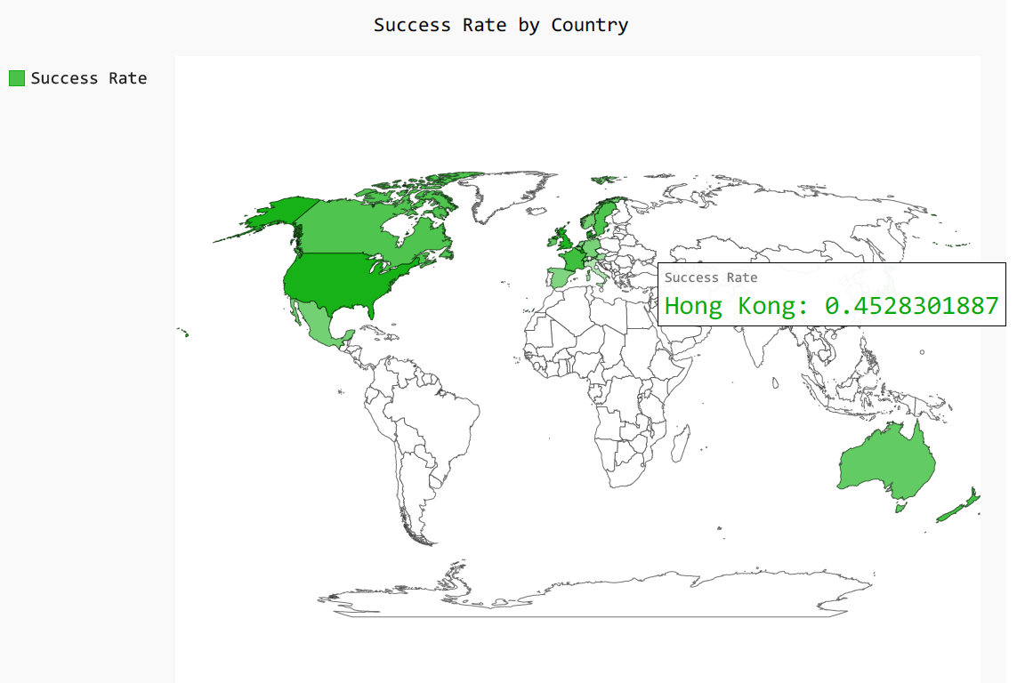
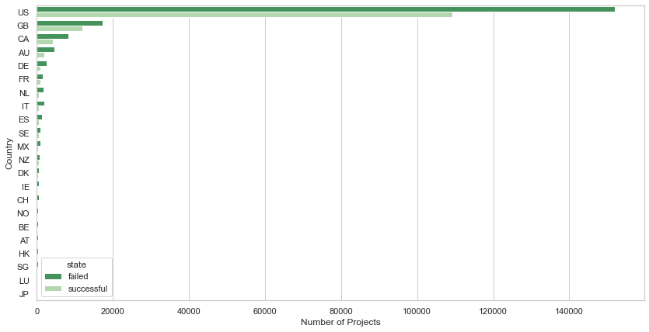
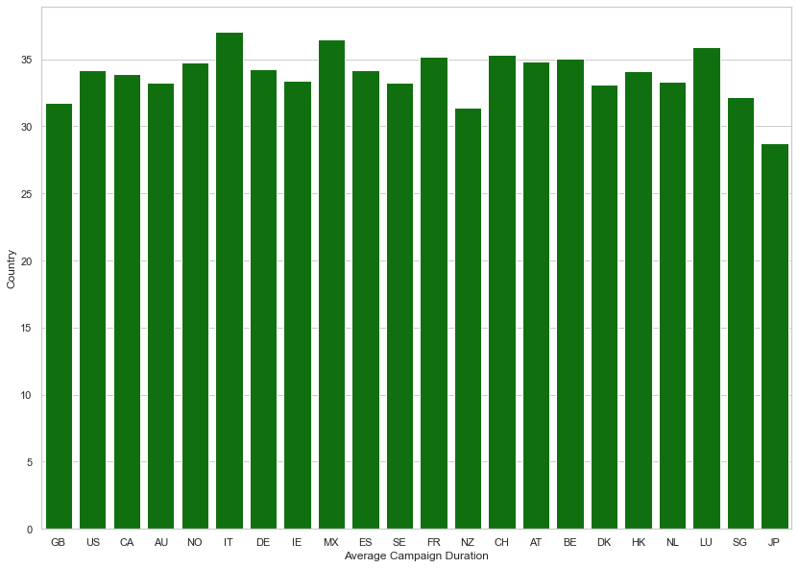
Geographic Analysis of Kickstarter Campaigns
Platform popularity in countries by the number of project campaigns
Most popular: USA and Great Britain
Least popular: Japan, Luxemburg and Japan
Average Campaign Duration: ranges between 28 to 37 days across all countries.
Success Rate: Calculated as the number of successful campaigns upon the total number of campaigns in a country
Hong Kong has the highest success rate even though it doesn’t have a lot of campaigns.

Slide 15

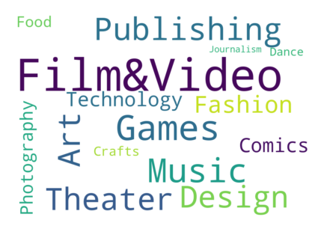
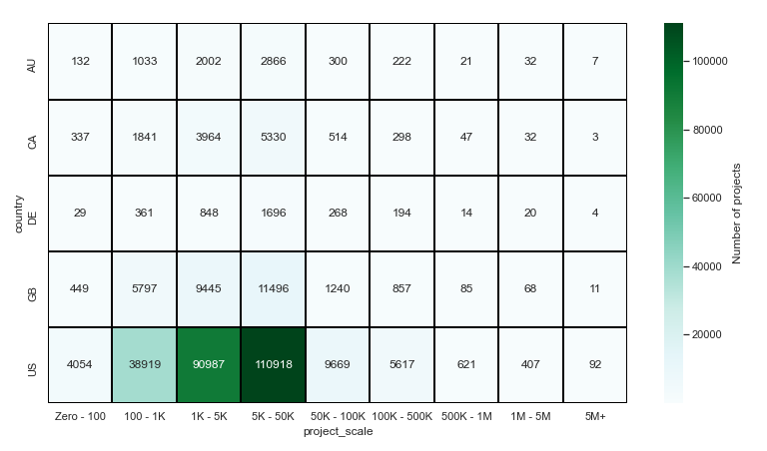
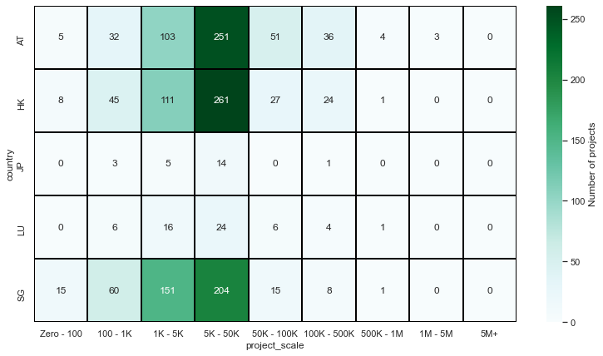
Understanding Campaign attributes within countries
Music is the most common main category of projects followed by Film and Video is US
The order is reversed for GB, with Film & Video being the most popular one
US
GB
Goal amount has been divided into ranges from $100 to $5M + to understand distribution of projects within ranges of project scale
Most projects fall within the $1K - $5K and $5K - $50K Targeted Goal amount category in both top and bottom countries
Top
Bottom

Slide 16
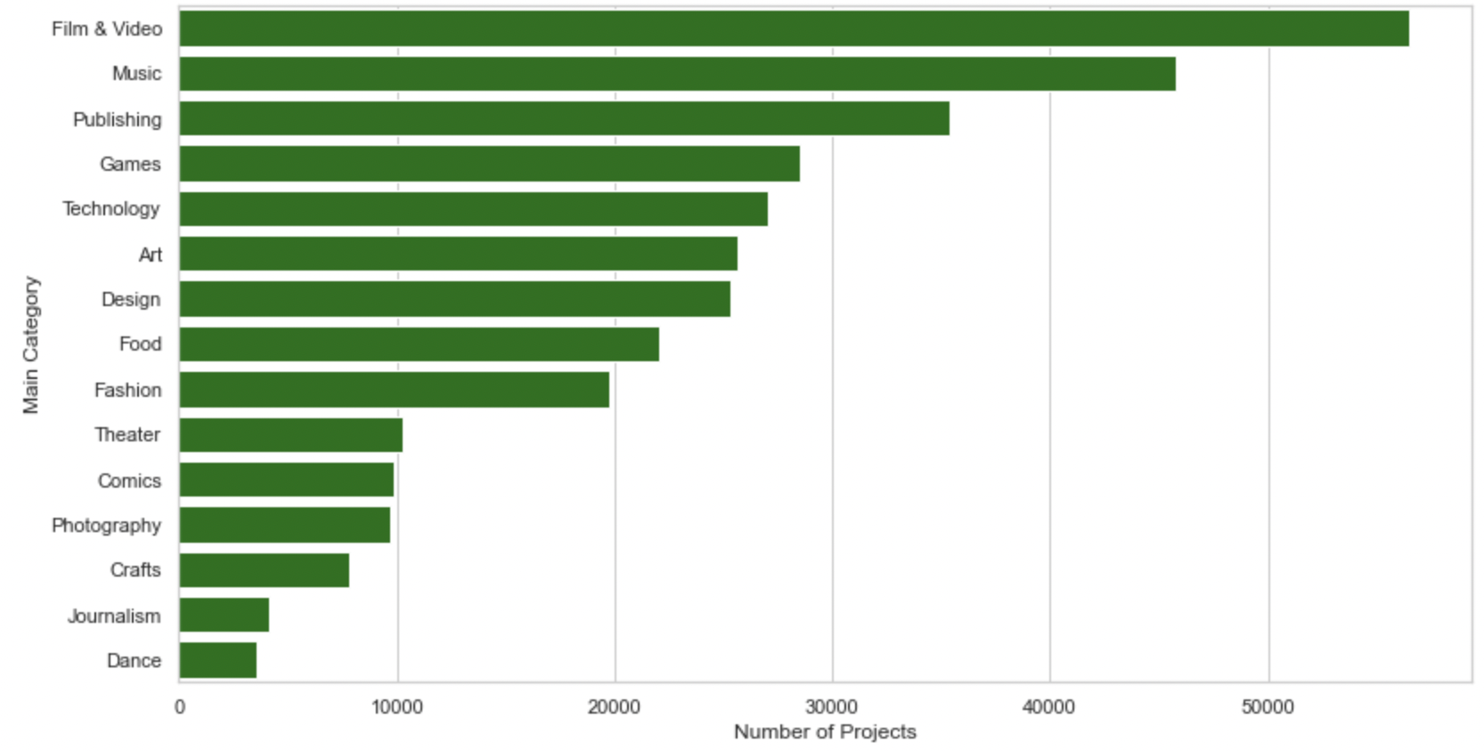
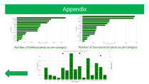
Categorical Analysis of Kickstarter Campaigns
Film & Video has the highest number of failed campaigns out of all the failed campaigns.
This is a preliminary analysis which helps us understand which project categories are successful on Kickstarter.
Insights:
Kickstarter Perspective: Kickstarter can identify the top successful campaigns in Film & Video, Publishing category and can develop targeted marketing campaigns to increase traffic of such category projects.
Creator Perspective: From the data, a creator can identify if the Kickstarter crowdfunding platform is the right platform for their respective product category.
Most popular: Film & Video, Music, Publishing
Least popular: Crafts, Journalism, Dance
Of all the successful campaigns, Music has the highest number of successful campaigns.

Slide 17
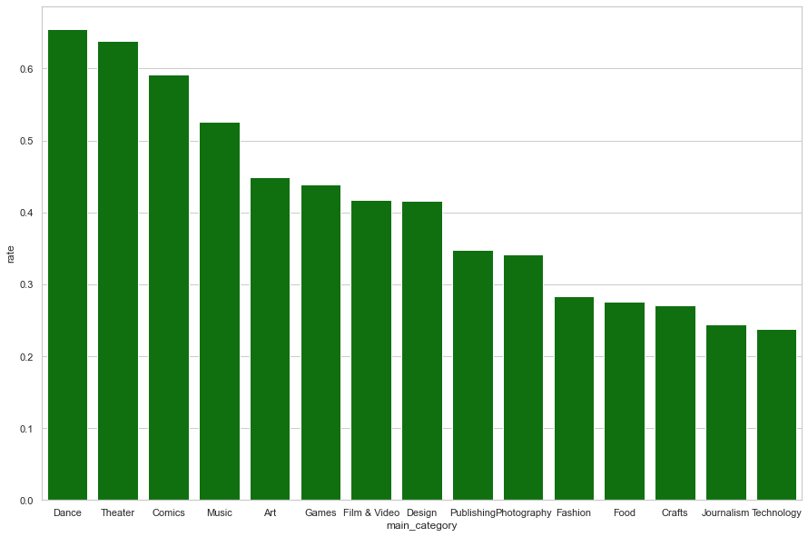
How does Success Rate vary across factors of Category?
Success rate = No. of Successful projects/Total Projects
Insights:
Dance and Theater have the highest success rates, while Journalism and Technology have the lowest.
Even though, Film & Video has the highest number of failed campaigns, its success rate is not the lowest.
Moreover, Music having the highest number of successful projects does not hold the highest success rate.

Slide 18
Business Impact On External Stakeholders
Project Backers
Project Hosts
Kickstarter – Crowdfunding Platform
Despite being red, Mars is a cold place, not hot. It’s full of iron oxide dust
Venus has a beautiful name and is the second planet from the Sun
Given basic project attributes like Category, Intended duration and Target Goal amount, what is the probability that a given campaign will succeed?​
What drives the success and failure of campaigns?​

Slide 19
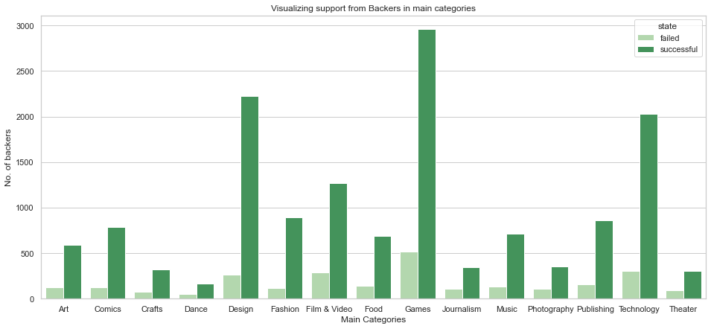
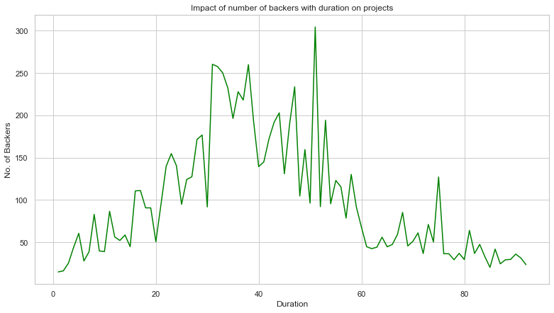
What Drives the Success and Failure of Campaigns
Through these graphs, we are visualizing the backer support in the main categories and duration.
As a Kickstarter user, what category you choose to put your project will have an impact on the success of the project. But external factors such as project scope and size will matter as well.
The ideal time duration to garner maximum backer support is 30 to 50 days.

Slide 20
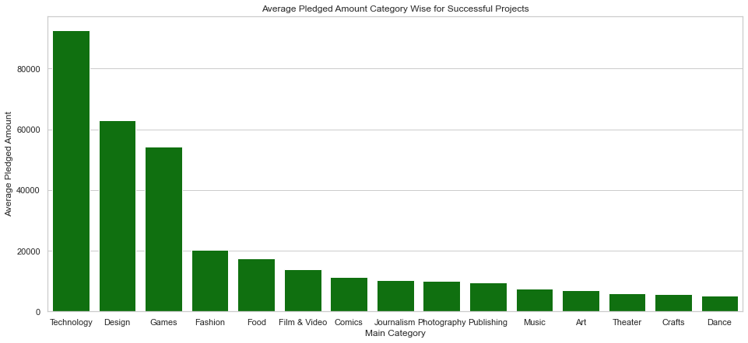
What Drives the Success and Failure of Campaigns
With this graph, we visualize the average pledged attained over the main categories historically.
This graph will enable Kickstarter’s individual customers answer the question: What pledged amount can I expect to raise for my project in x category?
The average pledged amount for technical projects is the highest projects and Dance is the lowest.

Slide 21
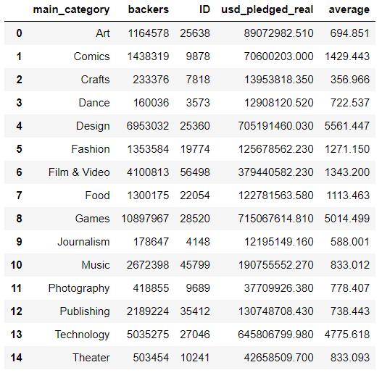
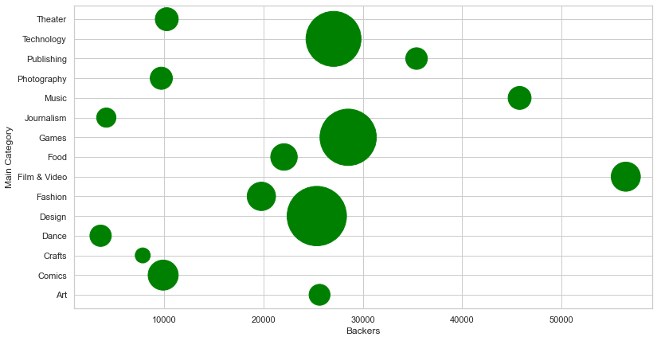
What Drives the Success and Failure of Campaigns
Through this visualization, we observe the mean pledged amount per backer for the main categories.
It impacts the end-user by answering the question: On an average, how many backers and how much investment can I expect for my project per backer?
Evidently, Technology, Games and Design have the highest mean pledged amount per backer with a good number of backers. While, Crafts does not receive enough backer support.

Slide 22
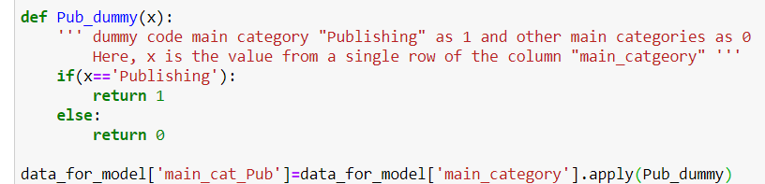
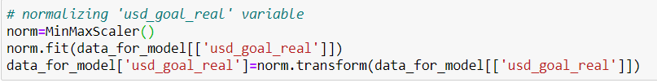
What is the probability that a given campaign will succeed?​
1
Predictive Analysis:
Decision tree model is used to classify a given campaign as success or failed on a set of initial variables like Category, Country and target goal
Variables Used:
Independent: usd_goal_real, main_category, category, country
Dependent: state
2
Dummy Coding
Need to convert categorical variables (“main_category”, “category”, “country”, “state”) to binary variables
1
3
2
Normalization
Normalizing “usd_goal_real” variable using MinMaxScaler function
3

Slide 23
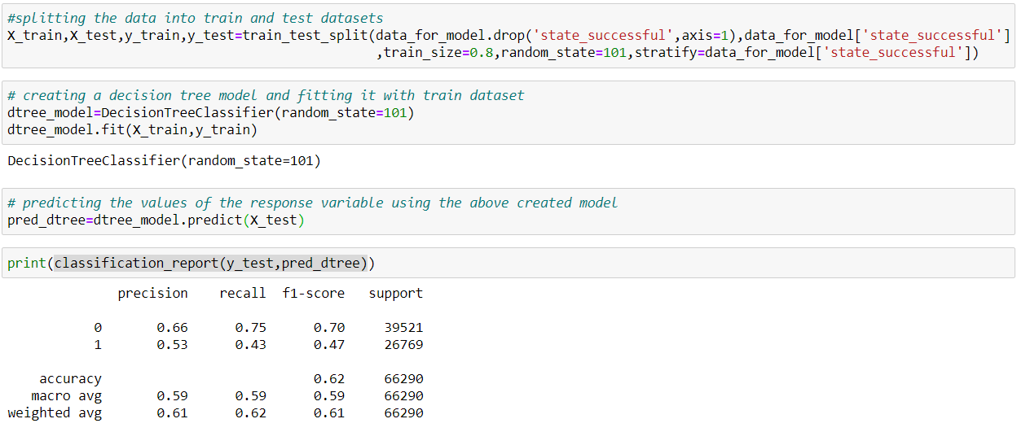
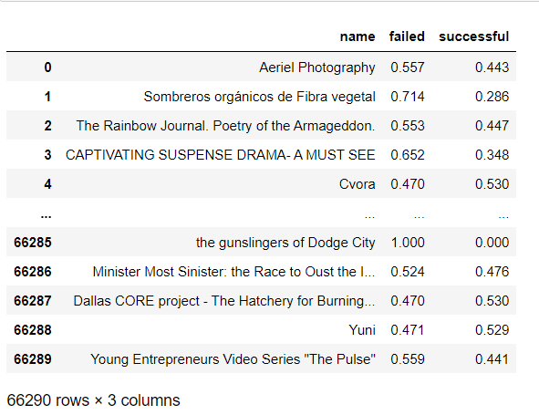
Output and Results
Sample Output
The model classifies a given campaign into Success and Fail with a classification accuracy of 62%
The probability obtained for each campaign is beneficial for the end user to fine tune their campaign parameters like duration or goal amount to improve chance of success

Slide 24
Recommendations and Next Steps
Expand to Countries with high success rate
Hong Kong which has shown a very high success rate (~45%) can be a potential market where Kickstarter can look towards improving its platform awareness through advertising and promotions.
1
Choose Categories with more backers and higher returns
Categories like Gaming have more backers, relatively higher success rates and lower goal amounts. Creators from this space can consider Kickstarter an ideal platform for crowdfunding. Kickstarter can also target this audience of creators and offer them lower commission rates.
2
Focus more on Customer Engagement
With observable reduction in customer engagement on the platform since 2015, Kickstarter should rethink its branding and market itself for better engagement from its users.
3
Implement a success probability calculation feature for end users
In the future, Kickstarter can integrate a predictive model on to the platform as shown to give the creators a better chance of rescoping their projects before hosting.
4

Slide 25
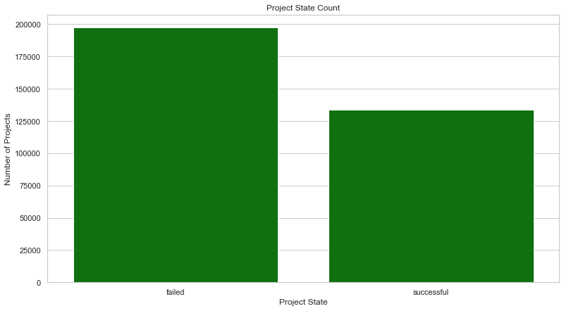
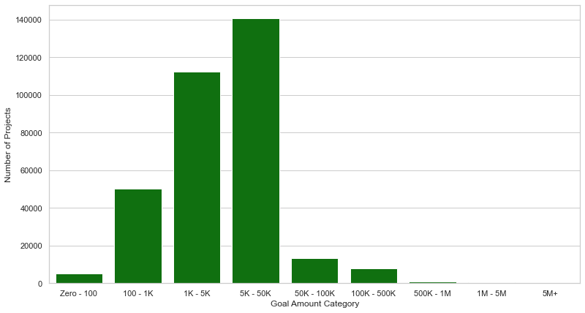
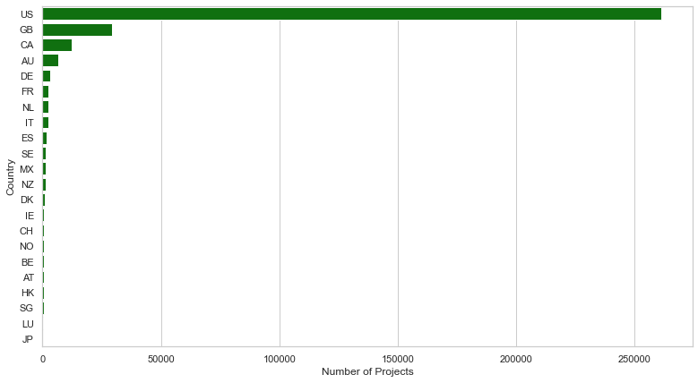
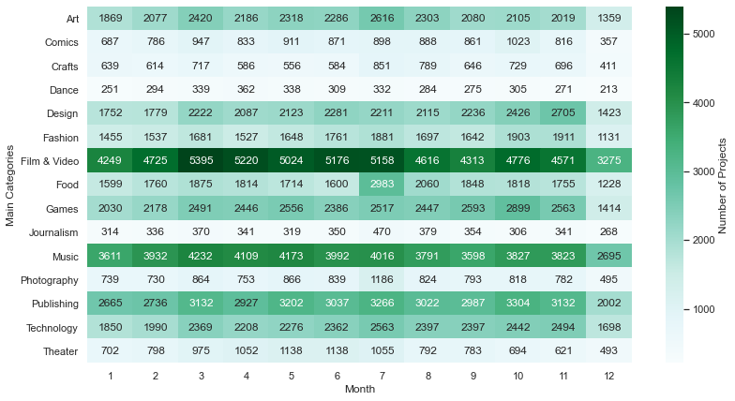
Appendix

Slide 26
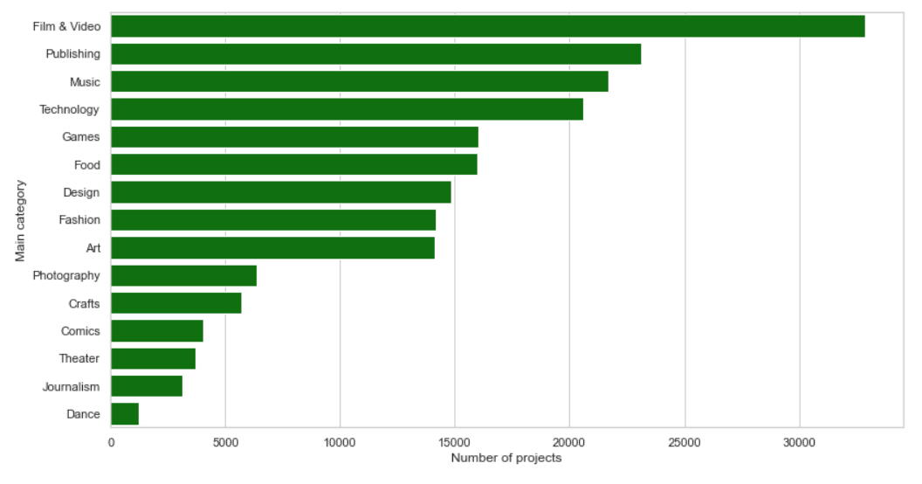
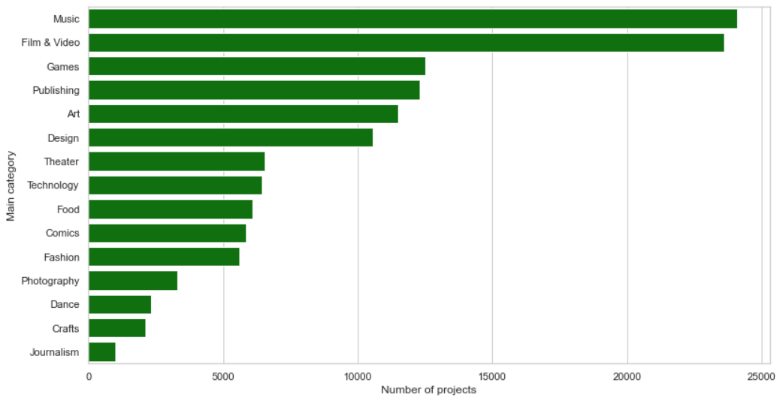
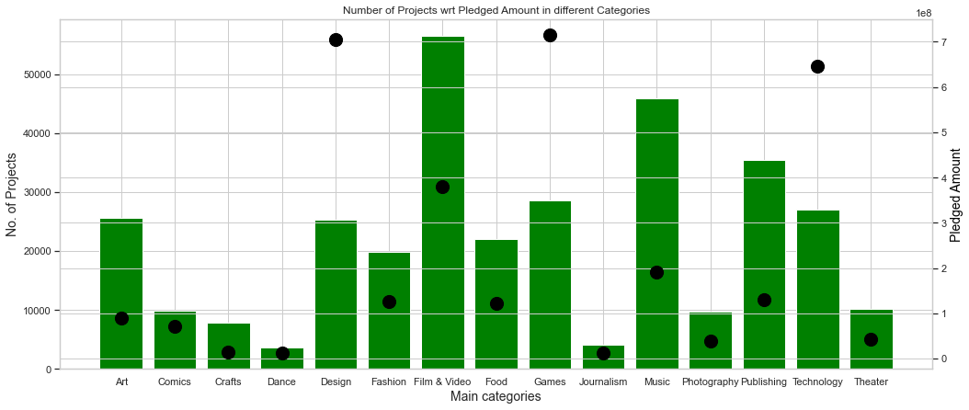
Appendix
Number of failed projects as per category
Number of Successful projects as per category

Slide 27
References
Kaggle Dataset: https://www.kaggle.com/kemical/kickstarter-projects
Kickstarter: https://www.kickstarter.com/about
Wordcloud: https://re-thought.com/creating-wordclouds-in-python/
Seaborn: https://seaborn.pydata.org/tutorial.html
Pygal: http://www.pygal.org/en/stable/documentation/types/maps/pygal_maps_world.html
Pandas Documentation: https://pandas.pydata.org/docs/reference/api/pandas.DataFrame.aggregate.html
Template Credits: https://slidesgo.com/

